Slide 1

MIS665 – Business Analytics / Data Mining Final Project Analysis of IMDB movie dataset using a variety of machine learning models including Regression, Classification, and Clustering
Josh Barlow
K-State Honor Code "On my honor, as a student, I have neither given nor received unauthorized aid on this academic work.“
Note that all red tabs on the left side have a sound button that contains audio.

Slide 2
Introduction
First Step: Data preparation
Removed columns that did not prove to be significant in the previous project
Created category column that scored 1-4 based on imdb_score
Reassigned values 1-5 to content rating (children’s movies up to adult movies)
Removed any rows that had null values
Moved imdb_score column to the front (I like doing this because when you plot a correlation heat map, it makes the y-variable (imdb_score) the far left column)

Slide 3
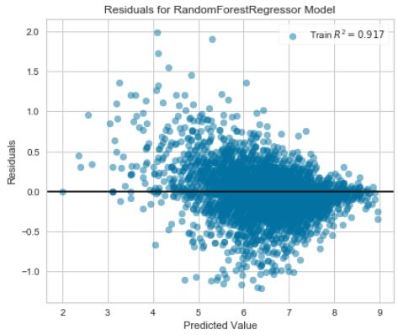
Regression Analysis
Ran ordinary least squares, lasso, and random forest regression models
Ran multiple models using all 14 variables that were remaining and ran models using only the top 5 variables
Random Forest was by far the most accurate (photo shows that results of the random forest model using all 14 variables)
Random Forest model with 5 variables still had an r-squared on the training data of 0.917

Slide 4
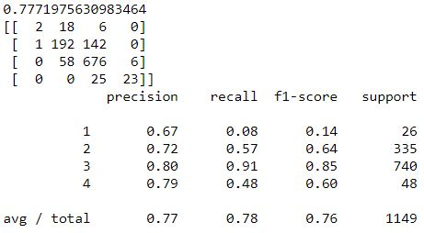
Classification
Created category column based on IMDB score
Decision Tree (.688 accuracy), KNN (.582), Logistic Regression Classifier (.687), Random Forest Classification (.777)
Ran 10-Fold Cross Validation on logistic regression classifier – verified 0.66-0.71
SelectKBest Feature Selection determined gross, num_voted_users, and budget were important
Decision Tree Classification using these variables had 0.644 accuracy

Slide 5
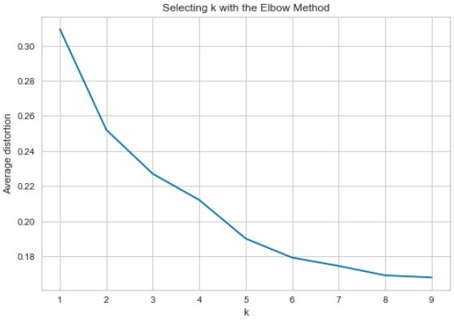
Clustering
Elbow method showed that somewhere around 3-4 clusters was appropriate
Normalized data
Clustered using K-Means with a model that included imdb_score and one that included category
both showed duration, num_voted_users, content_rating, and budget may be important
Hierarchical clustering with Agglomerative method got basically the same results

Slide 6
Storytelling
Based on the cluster analysis, there is evidence that potentially:
the longer the duration of the movie, the higher the imdb_score can be
the more critics for review, the higher the imdb_score
content rating may affect imdb_score - movies somewhere between PG-13 and R seem to have higher ratings
the higher the budget, the higher the imdb_score (movies in the highest rating clusters had nearly twice the budget as the other clusters)
the higher the number of voted users, the higher the imdb score
The random forest classifier is by far the most accurate to use for classification. I was able to achieve around a 74% accuracy with it. All of the classifiers seem to have trouble differentiating the bad movies though.
Random Forest was also significantly better than the other methods for regression analysis. Using all 14 variables that I narrowed down to, I was able to get a 91.7% r-squared which is very good. This shows that it may be very possible to predict how well a movie will be rated based on these variables. Even dropping down to num_voted_users, budget, duration, num_user_for_reviews, gross, I still had a 90% r-squared.

